Slide 1
Our Evolution

Slide 2
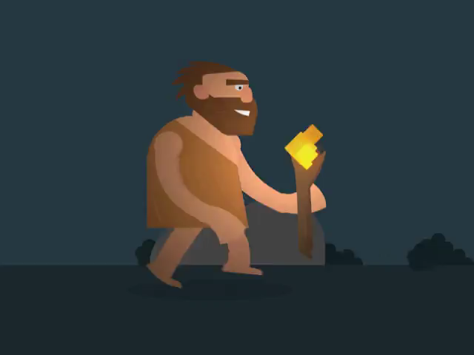
By the end of this lesson, you should be able to:
• | Understand our place in the Great Ape family tree.
• | Understand the major evolutionary changes in the hominin line.

Slide 3
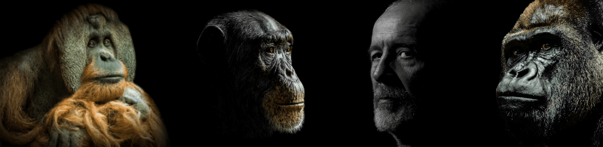
Humans are the product of a long evolutionary line. Our species, Homo sapiens, is the last surviving member of genus Homo, part of Family Hominidae (the Great Apes).
The living members of this family also include chimpanzees, bonobos, gorillas and orangutans.

Slide 4
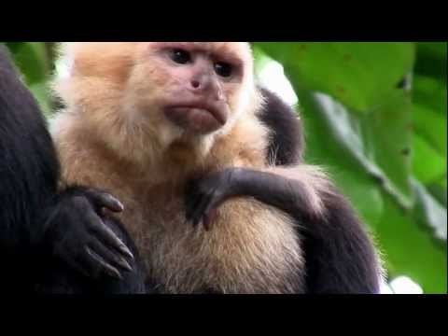

Slide 5
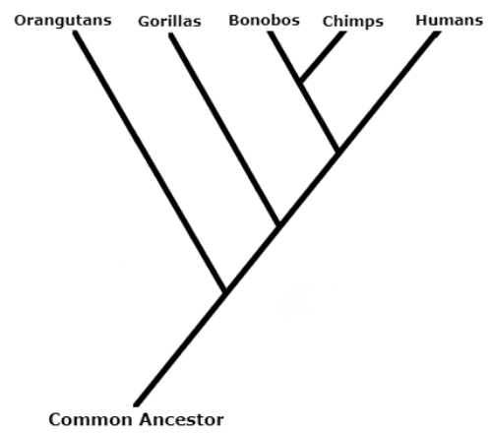
The image below shows the evolutionary tree of the Great Apes.
Evolutionary trees are constructed to illustrate the relationships between different species. They are based on comparative anatomy and embryology, the fossil record and DNA comparisons.

Slide 6
In the evolutionary tree, the lines of humans and chimpanzees meet. This doesn't mean that we evolved from chimpanzees! It means that humans and chimpanzees share a common ancestor.
In other words, the early ancestors of humans were ALSO the ancestors of chimpanzees.
In the same way, chimpanzees share a common ancestor with bonobos, and humans, chimpanzees, bonobos and gorillas all share a common ancestor with orangutans!

Slide 7
When groups diverge from the common ancestor, they develop and accumulate their own differences to eventually form brand new species.
Since our line diverged from the common ancestor with chimps, we have undergone a lot of evolutionary change, and formed several different species (though we are now the only ones left!).
The group that contains all modern humans and their extinct ancestors are known as Hominins.

Slide 8
Since diverging from the common ancestor, the hominin line has undergone a lot of evolutionary change!
Let’s go through some of the features that make us, us:
• | bipedalism
• | tool use
• | communication and learning
• | fire
• | agriculture, trade and civilisation

Slide 9
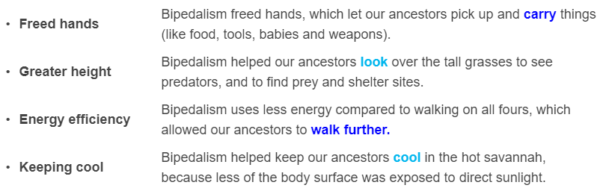
Bipedalism
Our ancestors were bipedal, which means that they walked on two legs instead of four. Bipedalism is thought to have evolved due to climate change, which altered the landscape from dense forests to open grasslands and plains.
Bipedalism would have been advantageous in these landscapes for the following reasons:

Slide 10
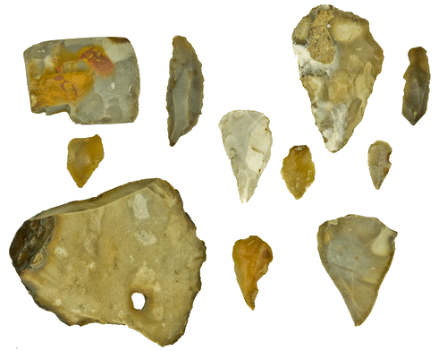
Tool Use
The first tools used by early humans were relatively simple - pieces of stone shaped or sharpened to serve different purposes. In time, they became more complex, culminating in hammers, needles, handaxes, spear tips and arrows.
Tools were used to hunt and process food, to make clothing, and to store items. This was very important in our evolution! Can you imagine trying to find, handle, and eat food without tools?

Slide 11
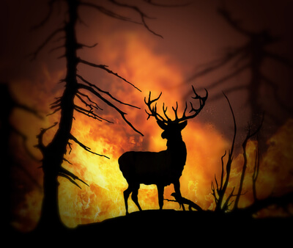
Fire
Early hominins learned to harness the power of fire.
Cooking food made it more nutritious, easier to chew and digest, and killed harmful parasites. The increased nutrition in cooked food contributed to brain development and growth. Fire protected hominins from predators, and helped them to flush out prey.
Fire also produced light and warmth, which made days longer, winters more bearable, and facilitated social interaction.

Slide 12
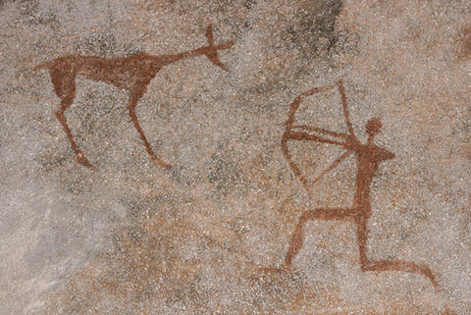
Communication and Learning
Our ancestors preserved the knowledge gained over generations by communicating with offspring, and built on this past knowledge to gain deeper insights. They were the first animals on Earth to do this!
This type of communication eventually led to the development of sociality and culture.

Slide 13

Agriculture, Trade and Civilisation
The rise of agriculture meant that people could settle in one place, specialise, and rely on the different skills of others.
Agriculture gave us a reliable and predictable food source. Foodstocks required protection, which led to communities living together in villages, towns, cities, kingdoms and eventually empires.

Slide 14
